Slide 1

EMEA and APAC
Approved Special Order Items

Slide 2
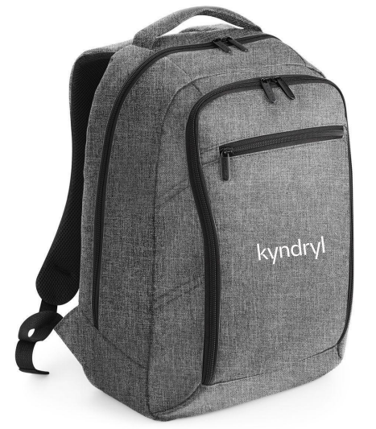
EXECUTIVE DIGITAL BACKPACK
Triple compartment design. Laptop compatible up to 17 inches. Padded laptop compartment. iPad mini/Tablet compatible | Document section. Detachable adjustable shoulder strap with pad. Zippered front pocket | Organiser section. USB memory stick loops | Wheelie bag strap. Padded handle. Capacity: 13 litres.
MOQ – 50
Approx. €42.00 per unit
*Confirmed price on application

Slide 3
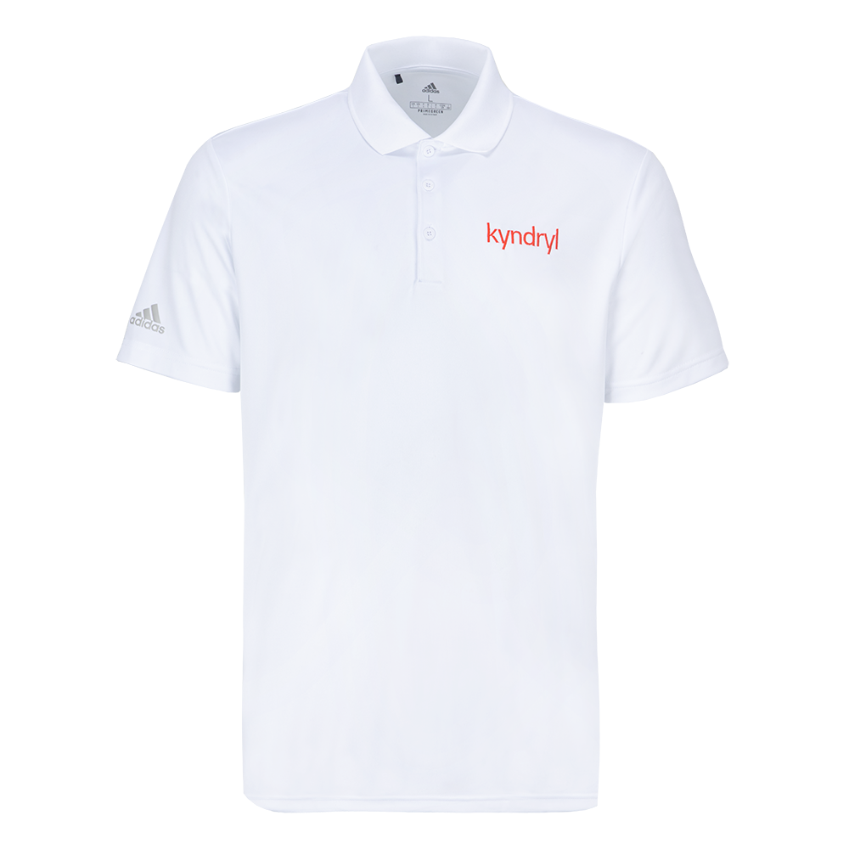
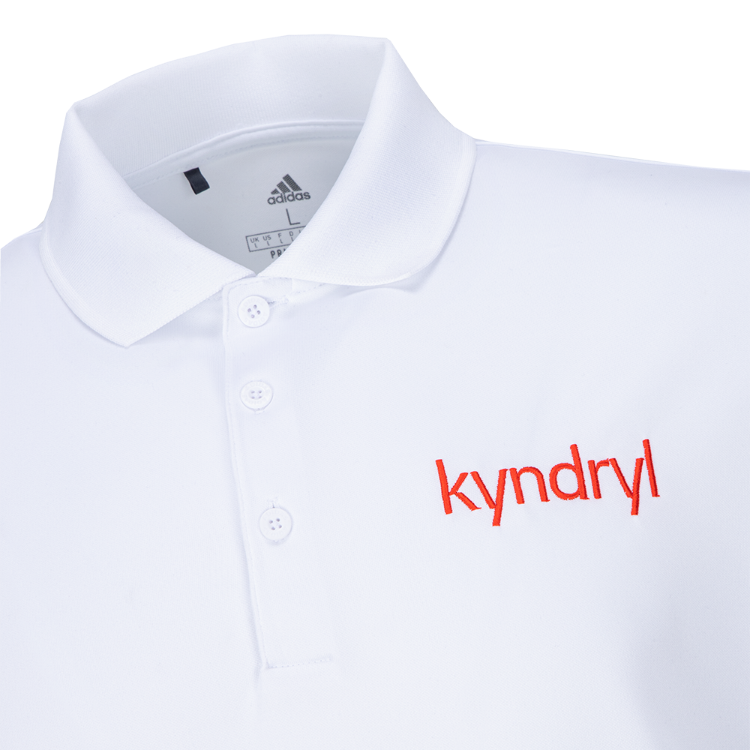
UNISEX RECYCLED ADIDAS POLO SHIRT
This lightweight polo is made from breathable, moisture-wicking fabric for all day comfort.
MOQ – 50
Approx. €55.00 per unit
*Confirmed price on application

Slide 4
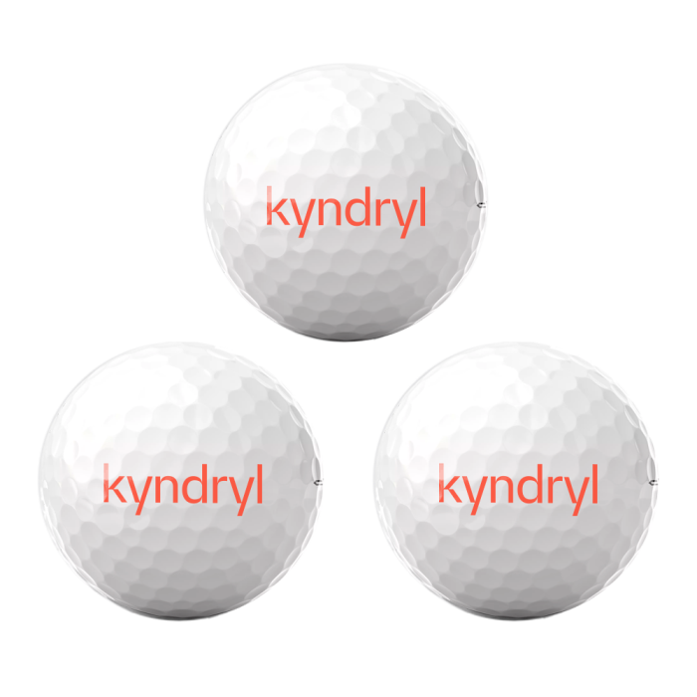
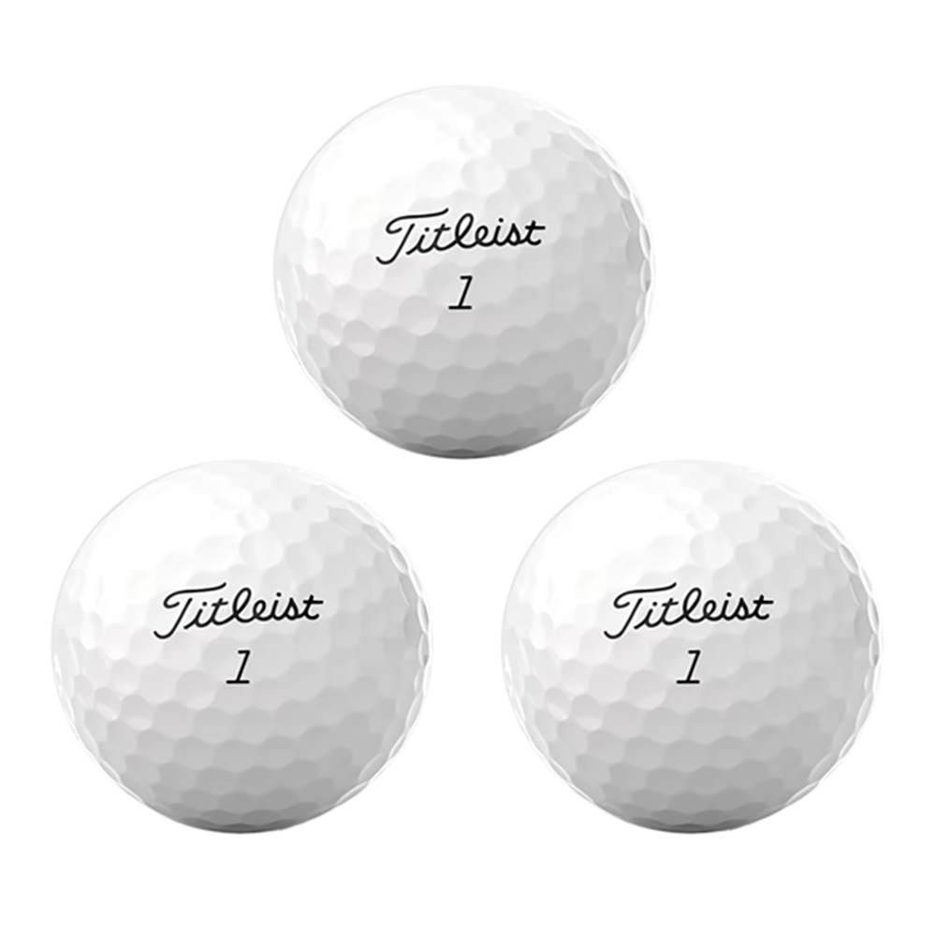
TITLEIST PRO V1 GOLF BALLS
MOQ – 12 DOZEN
*Confirmed price on application

Slide 5
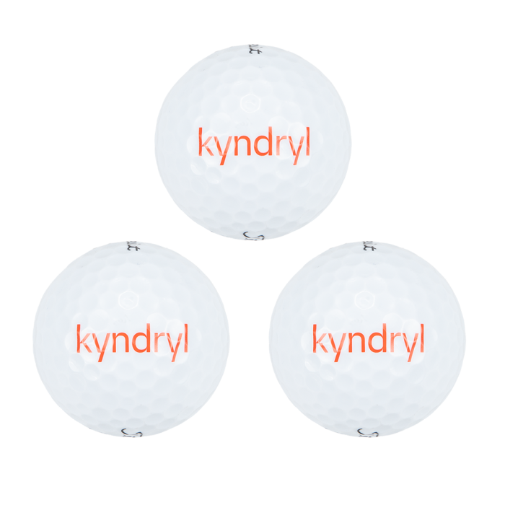
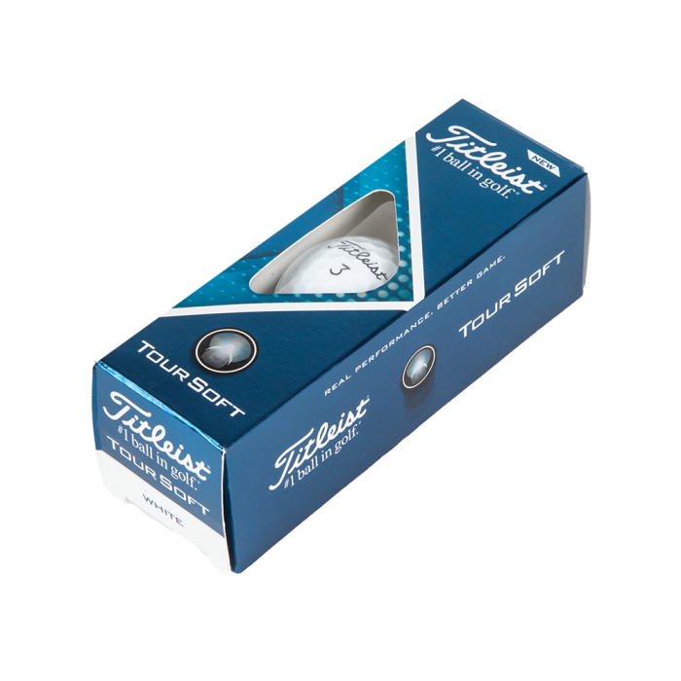
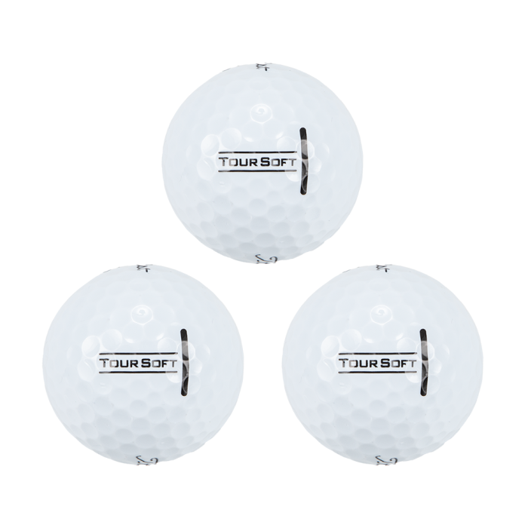
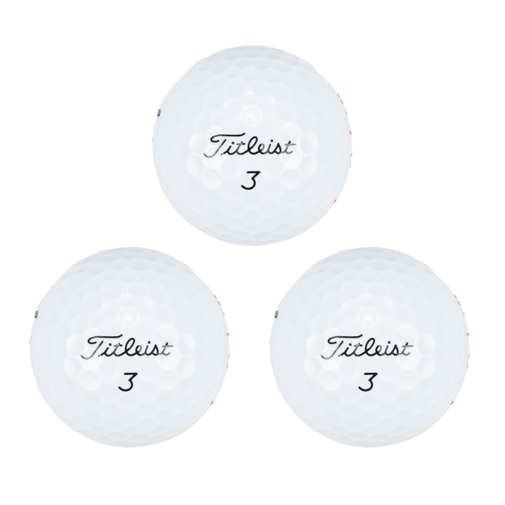
TITLEIST TOUR SOFT GOLF BALLS
MOQ – 12 DOZEN
*Confirmed price on application

Slide 6
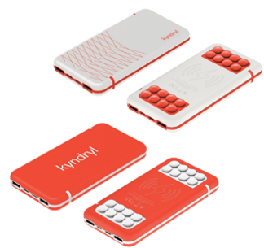
5000mAh POWERBANK
This powerbank keeps your wireless mobile devices fully charged, even on the go.
MOQ – 50
Approx. Price - €40.20 per unit
*Confirmed price on application

Slide 7
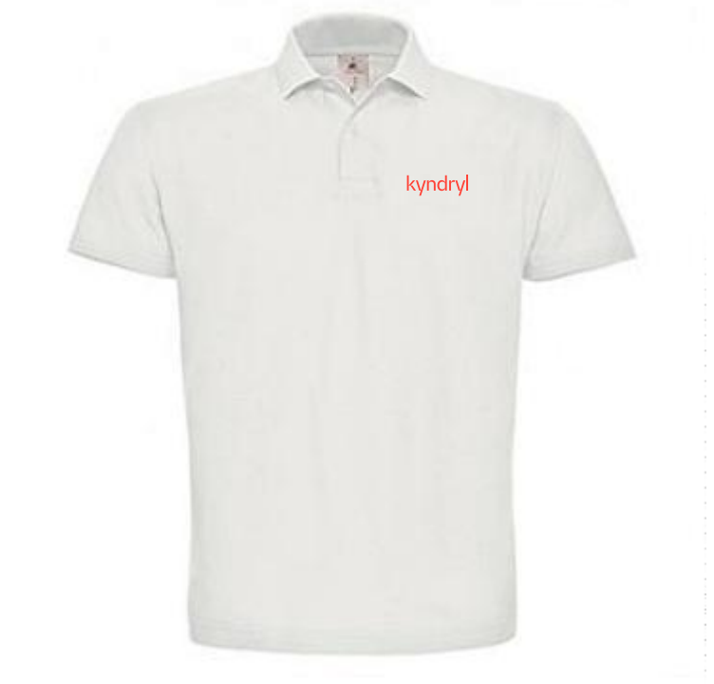
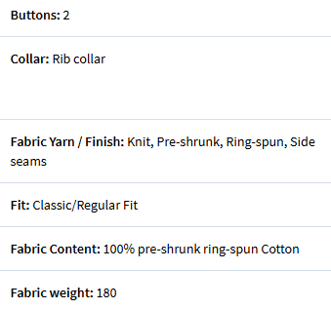
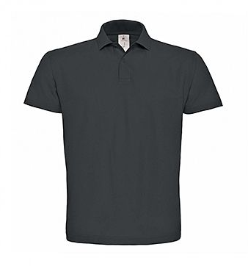
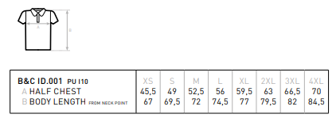
WHITE POLO SHIRT (also approved in Anthracite)
Unisex polo shirt manufactured by B&C, made of pre-shrunk fabric. With short sleeves, knitted 1x1 collar, side seams, plaque with 2 buttons in the same colour and interlining, reinforced neckband.
MOQ – 25
Approx. Price - €12.00 per unit
*Confirmed price on application

Slide 8
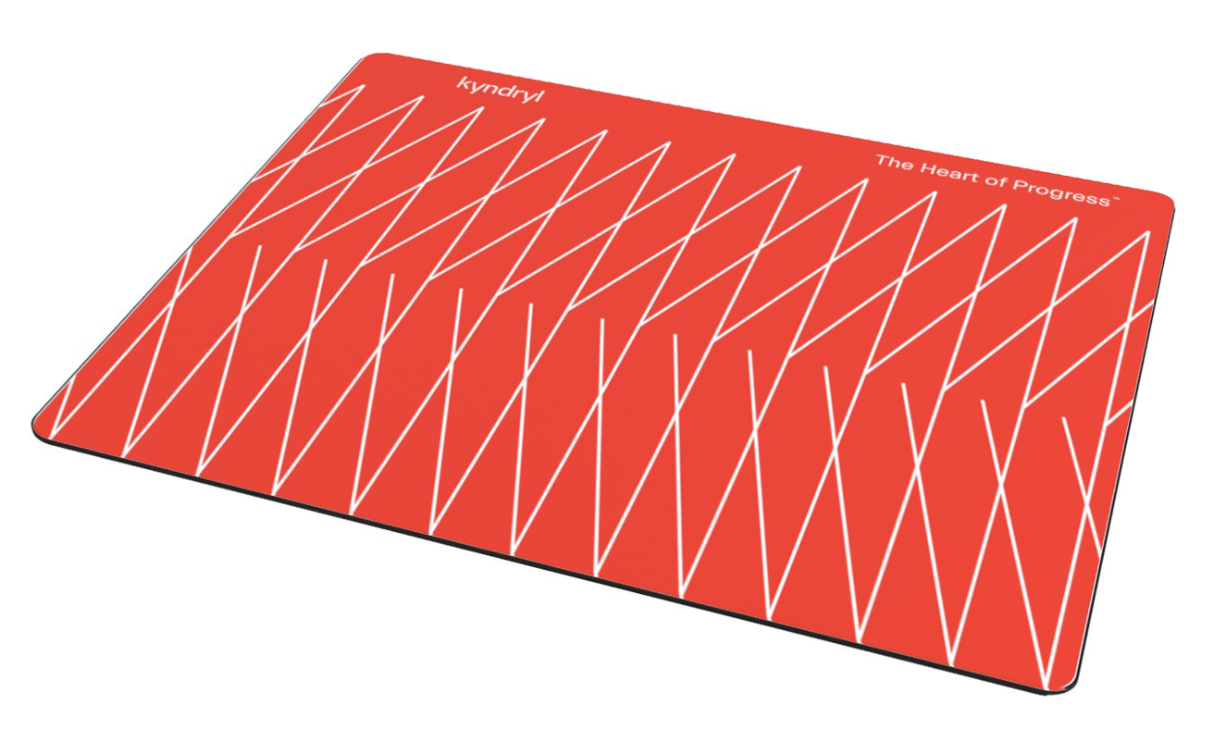
BRITE-MAT® RECTANGULAR MOUSE MAT
One of the bestselling hard top mouse mats on the market. It offers unrivalled quality due to our patented in-mould labelling technique. It’s moulded from 100% in-house recycled plastics. 100% perfect mouse control for standard balled and optical mice. Laminated paper, Recycled Plastic.
MOQ – 100
Approx. Price - €3.00 per unit
*Confirmed price on application

Slide 9
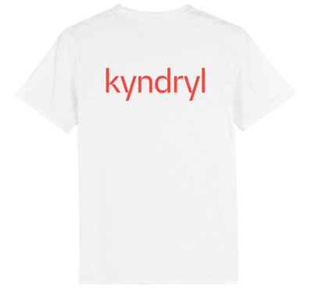
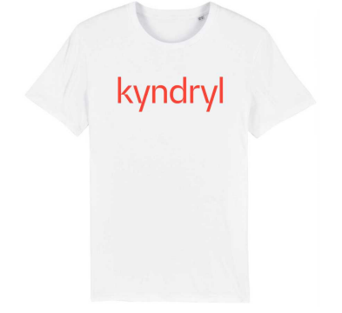
WHITE T-SHIRT
Stanley Stella Creator t-shirt (as per inventory item) which can be printed to the front and back with a large Kyndryl logo in Warm red.
MOQ – 100
Approx. Price - €13.00 per unit
*Confirmed price on application

Slide 10
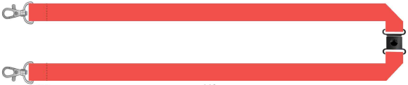
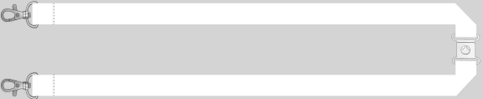
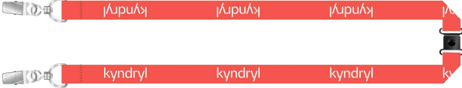
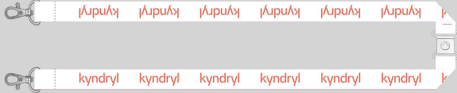
LANYARD WITH TWO CLIPS
RPET polyester
Safety Break
Two clips for use with badge holders
MOQ – 500
Approx. Price - €2.00 per unit
*Confirmed price on application

Slide 11
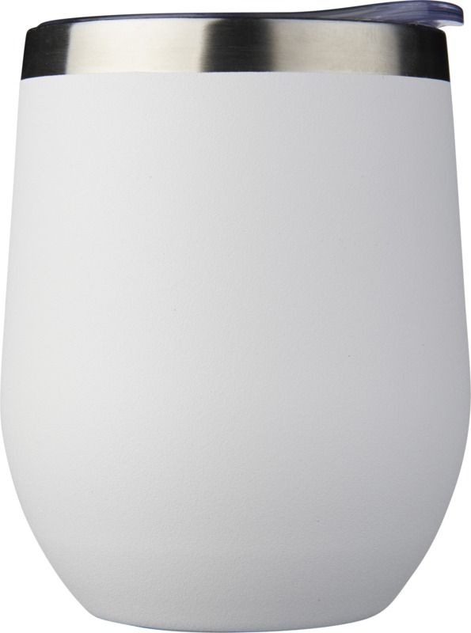
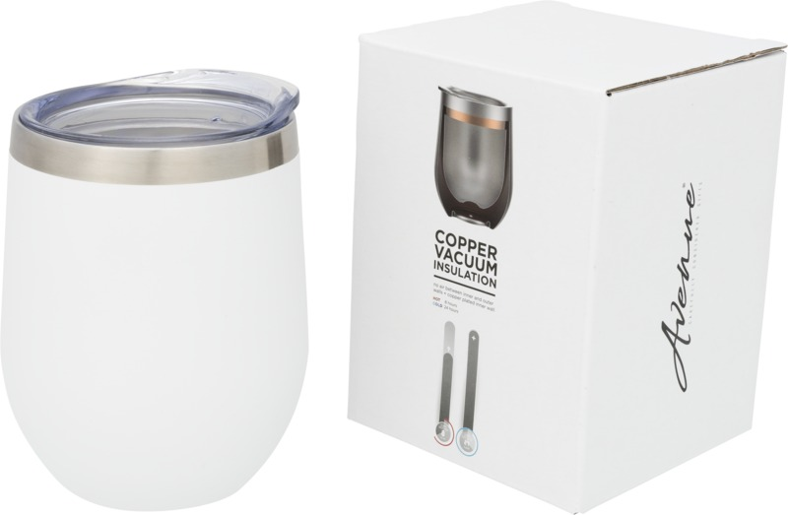
350ML COPPER VACUUM INSULATED CUP
Copper vacuum insulated cup has a double-wall vacuum construction with copper insulation which means it keeps drinks hot for 6 hours and cold for 24 hours. The construction prevents condensation on the outside of the tumbler. Easy sipping, push-on lid. Features spray powder coating on the outer body. Wide opening for comfortable filling and pouring. Volume capacity is 350ml. Presented in an Avenue gift box. Stainless Steel.
MOQ – 50
Approx. Price - €11.00 per unit
*Confirmed price on application

Slide 12
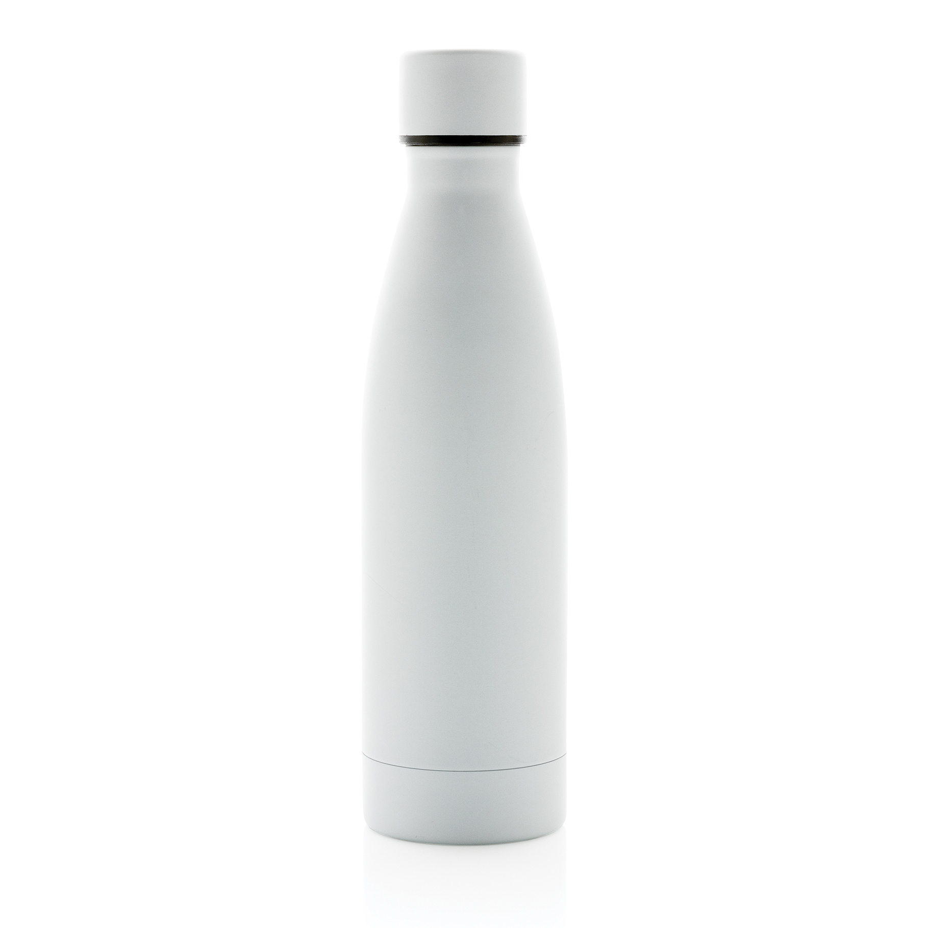
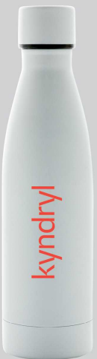
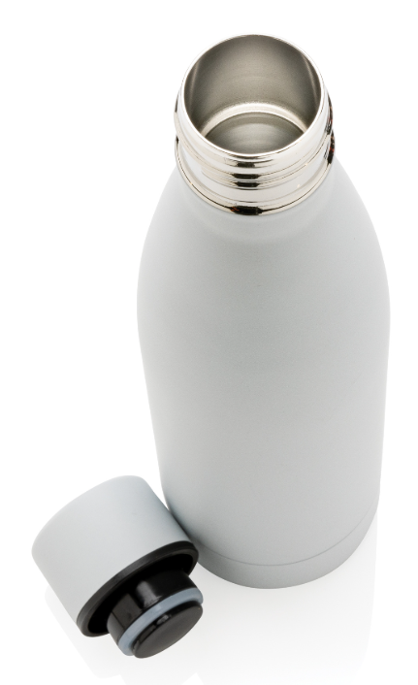
RCS RECYCLED STAINLESS STEEL VACUUM BOTTLE
This RCS Recycled stainless steel vacuum bottle is designed for long-lasting enjoyment of your drinks! The double-wall recycled stainless steel vacuum construction keeps beverages chilled for up to15 hours or warm for up to 5 hours. This bottle fits most standard car cup holders so you can bring it with you anywhere. Made with RCS (Recycled Claim Standard) certified recycled materials. RCS certification ensures a completely certified supply chain of the recycled materials. Total recycled content: 93% based on total item weight. BPA free. Capacity 500ml. Including FSC®-certified kraft packaging.
MOQ – 25
Approx. Price - €14.00 per unit
*Confirmed price on application

Slide 13
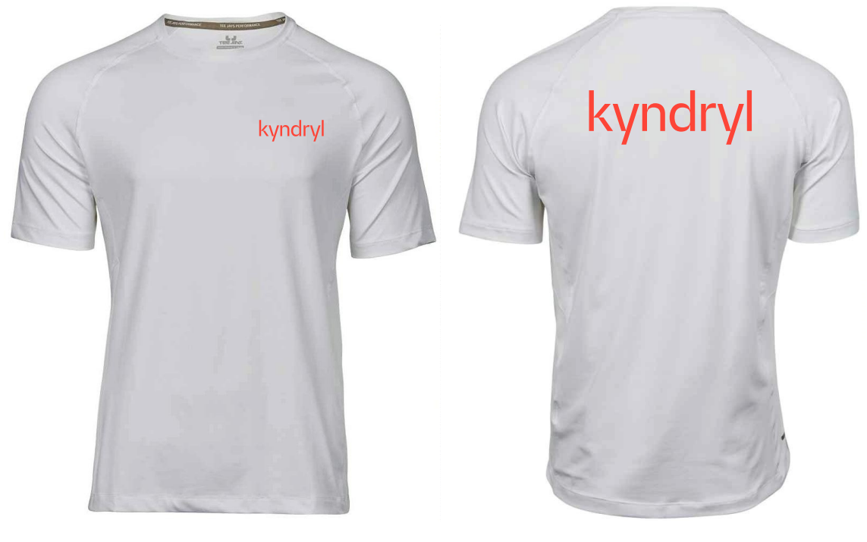
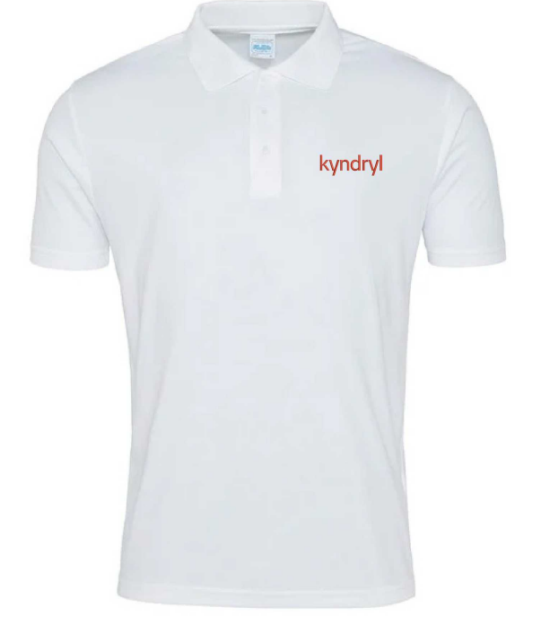
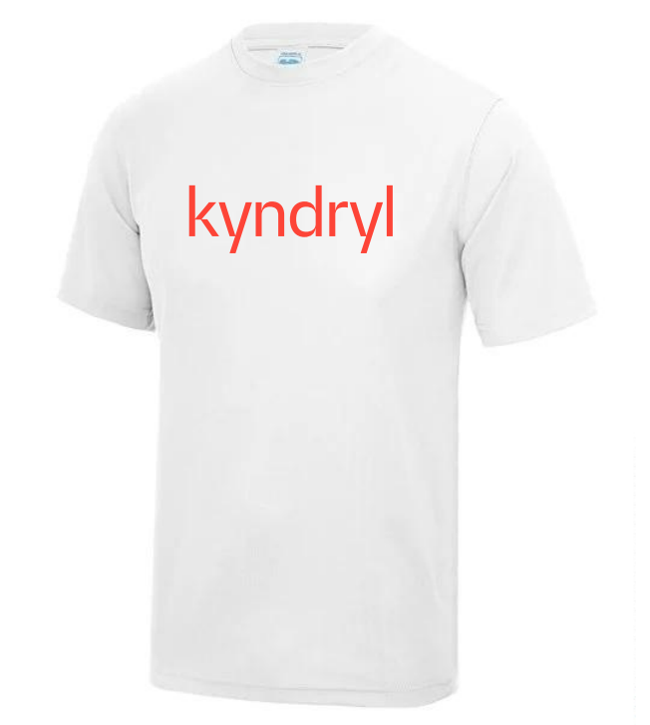
DRI FIT T-SHIRTS
Relaxed fit
Set in sleeve design
Self-fabric taped back neck
Twin needle stitching detail
Self-fabric crew neck
Fabric: Polyester
MOQ – 25
Approx. Price – to be confirmed, depending on the branding method, size and number of logos.

Slide 14
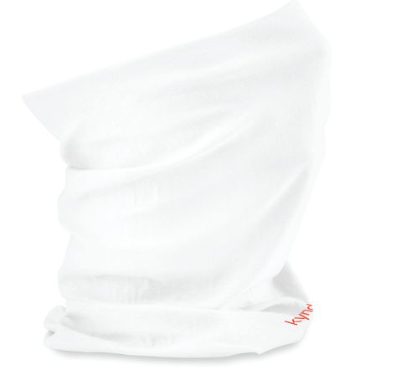
SNOOD
100% Recycled Polyester. Equivalent to approx. 1.5 post-consumer bottles. Ultra thermal fabric. Flatlocked seams. Anti-pill finish. Contoured design. Glove friendly cord adjuster. Elasticated drawcord with toggle. TearAway label. Beechfield makes no warranties, either express or implied, that the product prevents infection or the transmission of viruses or diseases
MOQ – 100
Approx. Price - €5 per unit
*Confirmed price on application

Slide 15
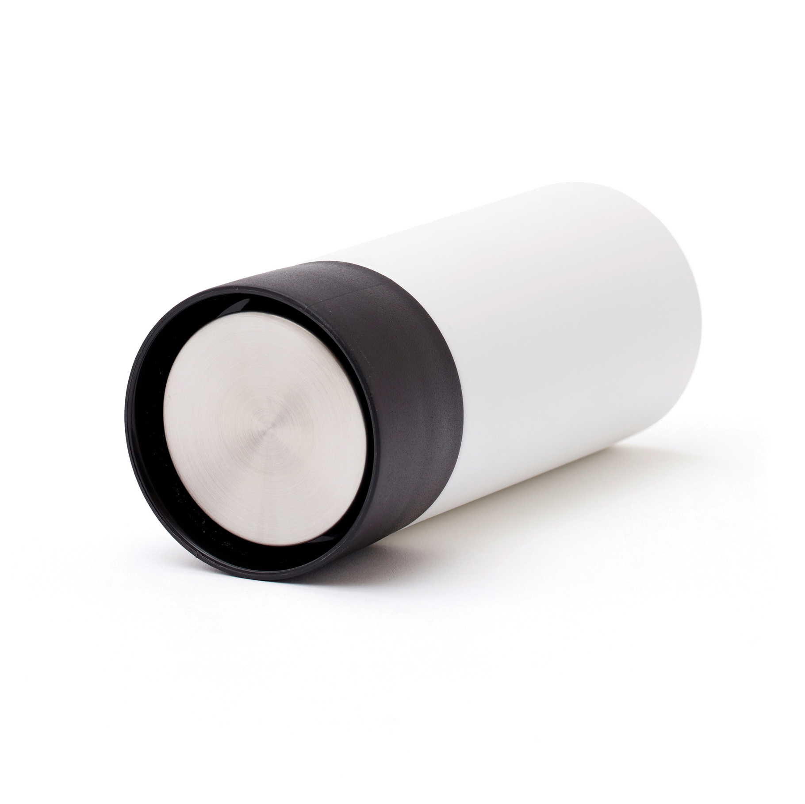
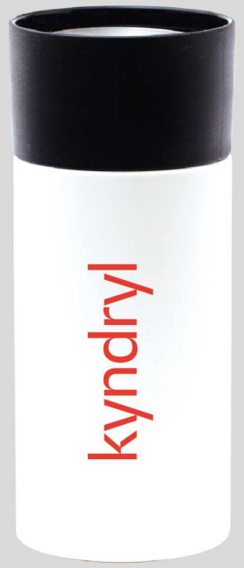
THERMAL MUG
A simple solution to make your everyday life better is to get a to go mug which can be opened with only one hand. Always on the run? Then this mug will be your favourite, keeps cool and warm for 6 hours. It is produced in 18/8 steel and because of that choice of material neither smell nor taste will linger in the mug. Handwash only! 300 ml.
MOQ – 25
Approx. Price - 19.47 € per unit
*Confirmed price on application

Slide 16
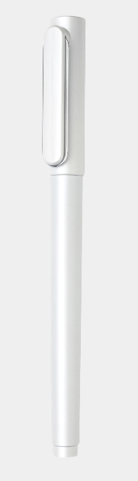

PEN WITH ULTRA GLIDE INK
An ideal writing companion that everyone can enjoy and the new brother of the current X6 pen. The X6 cap pen contains a low viscosity ink which provides even more writing smoothness. The low viscosity ink ensures more ink flow than higher viscosity inks for fluid luxurious strokes. Writing length 800 metres. Writing colour blue.
MOQ – 25
Approx. Price – 5.03€ per unit
*Confirmed price on application

Slide 17
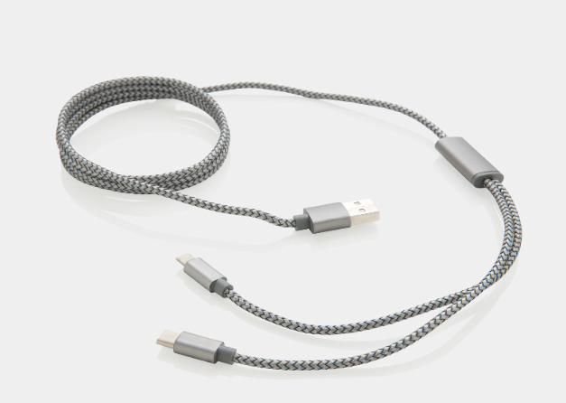
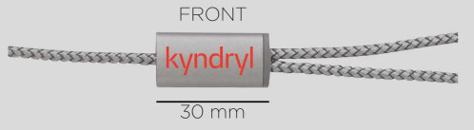
3-IN-1 BRAIDED CABLE
Nylon ● Max current 5V/2A ● Lightning Output ● USB-C output ● Micro USB output ● 120cm charging cable ● USB-A input
MOQ – 25
Approx. Price – 8.08€ per unit
*Confirmed price on application

